Slide 1
Processing and characterization of micro-nanostructured films of CdS and its application in photovoltaic devices
Ricardo Navarro Jiménez

Slide 2


Introduction
My thesis project consist on making nanowires on a thin layer of cadmium sulfide (CdS) and apply it in photovoltaic devices to enhance its effectivity
After having that I follow few steps to make it possible to grow the nanowires all over the surface of the thin layer of CdS
CdS nanolayer
Sn0 nanolayer
Conductive glass
CdS nanowires

Slide 3
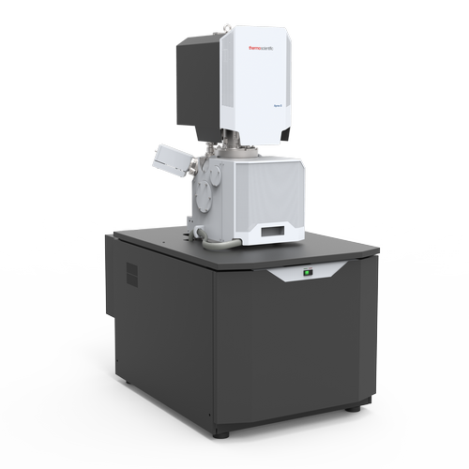
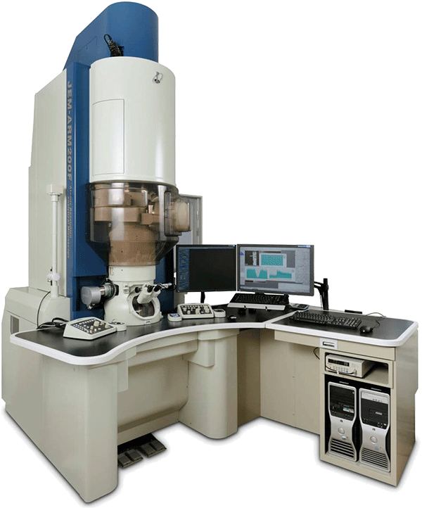
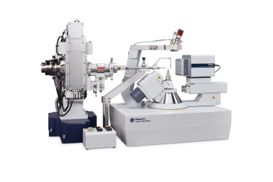
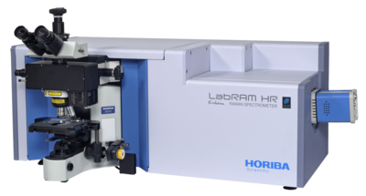

Characterization methods
1. – SEM (Scanning Electron Microscope)
2. – TEM (Transmission Electron Microscope)
3. – XRD (X-Ray Diffraction)
4. –Raman
5. – PL (Photoluminescence)

Slide 4
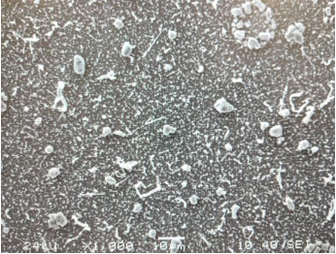
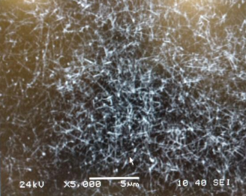
Scanning Electron Microscope (SEM)
Analyze the morphology.
Measure the size of nanotubes

Slide 5


Scanning Electron Microscope (SEM)
WHY?
To see if the nanowires can be consider nanowires.
Know how the structure have been made.
How scattered the nanowires are on the surface.
Actions to take
If they are consider nanowires repeat the process.
Rectify the quantity of nanowires is acceptable to the purpose.

Slide 6
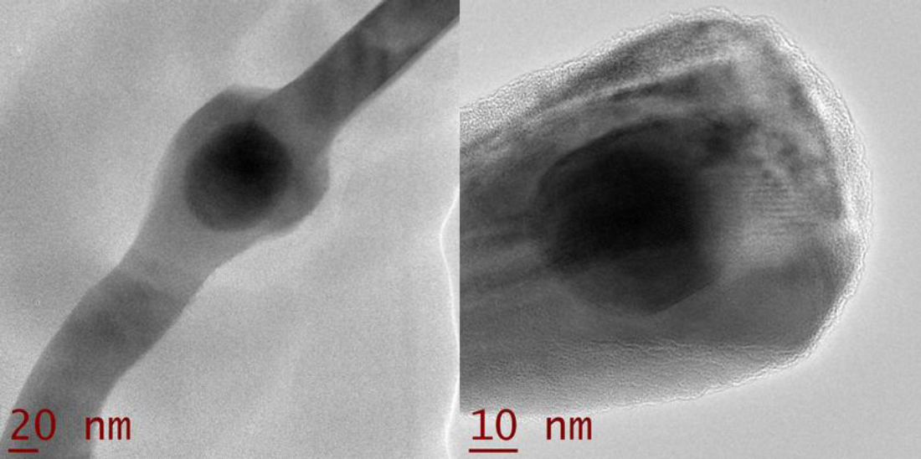
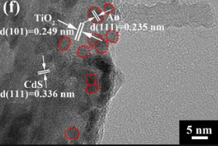
Transmission Electron Microscope (TEM)
See the inner structure
Measure the size of the molecules

Slide 7

Transmission Electron Microscope (TEM)
WHY?
Easy to see the nanowires on the inside.
Easier to measure the grain size that SEM.
Know what happen with the precursor (bismuth).
Actions to take
Describe how are growth each nanowire.

Slide 8
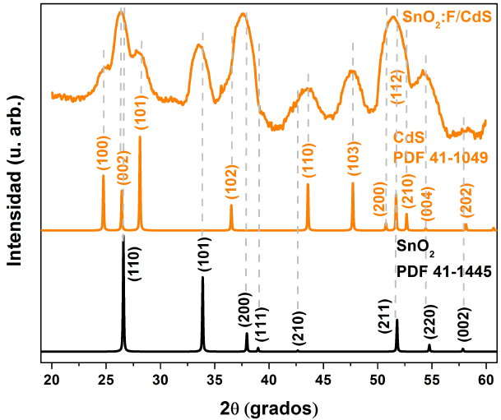
X-Ray Diffraction (XRD)
Make sure that the elements of the sample are the ones desire.

Slide 9


X-Ray Diffraction (XRD)
Actions to take
Determine if there are not any element that we do not want to have.
WHY?
It is helpful to determine the composition of the samples.

Slide 10
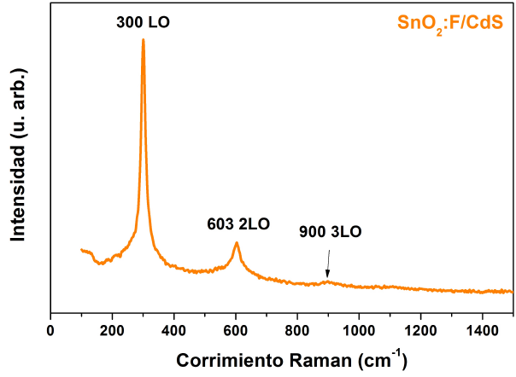
Raman
See the crystallography of the sample.
The peaks at 603 and 900 means that the sample has a good crystallography.

Slide 11


Raman
WHY?
Raman can show of a very reliable way the compounds in my sample.
I can know the elements in the sample.
Actions to take
Describe the elements of the sample and it’s crystallography.

Slide 12
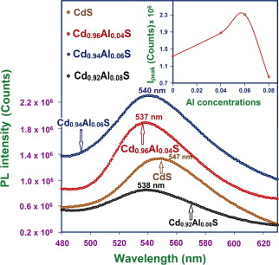
Photoluminescence (PL)
The reaction of the sample to the light.

Slide 13


Photoluminescence (PL)
WHY?
See if there are imperfections on the sample.
Verify the sample reacts to the light the way the literature say.
Actions to take
In case of imperfections repeat the process to get a better sample.
Rectify the band gap of CdS.

Slide 14
Conclusion
The use of the mention methods were chosen by my assessor and me because we determined they were the more suitable ones to my thesis project.
Some of the methods can give us the same information for example we can obtain the crystallography structure from Raman and XRD but we want to use them to obtain different results that can support my work.
I still not have results of any method but SEM, but based on the literature we can conclude this methods are the optimums.

Slide 15
References
*Goldstein, J. I., Newbury, D. E., Michael, J. R., Ritchie, N. W., Scott, J. H. J., & Joy, D. C. (2017). Scanning electron microscopy and X-ray microanalysis. Springer.
* Williams, D. B., & Carter, C. B. (1996). The transmission electron microscope. In Transmission electron microscopy (pp. 3-17). Springer, Boston, MA.
* Cao, A., Xu, C., Liang, J., Wu, D., & Wei, B. (2001). X-ray diffraction characterization on the alignment degree of carbon nanotubes. Chemical physics letters, 344(1-2), 13-17.
* Zhang, Y., Xue, C., Xue, Y., Gao, R., & Zhang, X. (2005). Determination of the degree of deacetylation of chitin and chitosan by X-ray powder diffraction. Carbohydrate research, 340(11), 1914-1917.
* Colthup, N. (2012). Introduction to infrared and Raman spectroscopy. Elsevier.
* Mooradian, A. (1969). Photoluminescence of metals. Physical Review Letters, 22(5), 185.
* Qu, L., & Peng, X. (2002). Control of photoluminescence properties of CdSe nanocrystals in growth. Journal of the American Chemical Society, 124(9), 2049-2055.
* Ford, B. J., Joy, D. C., & Bradbury, S. (2016). Scanning electron microscope (SEM). Encyclopædia Britannica. May, 17.
* Reimer, L. (2013). Transmission electron microscopy: physics of image formation and microanalysis (Vol. 36). Springer.
*Wang, L., Song, H. W., Liu, Z. X., Ma, X., Chen, R., Yu, Y. Q., ... & Luo, L. B. (2015). Core–shell CdS: Ga–ZnTe: Sb p–n nano-heterojunctions: fabrication and optoelectronic characteristics. Journal of Materials Chemistry C, 3(12), 2933-2939.
*Gao, X., Liu, X., Zhu, Z., Gao, Y., Wang, Q., Zhu, F., & Xie, Z. (2017). Enhanced visible light photocatalytic performance of CdS sensitized TiO 2 nanorod arrays decorated with Au nanoparticles as electron sinks. Scientific reports, 7(1), 973.
*M en C. Karla Gutiérrez Zayas-Bazán, Estudio de capas ultradelgadas absorbentes aplicadas a celdas solares (tesis doctoral), Instituto Politécnico Nacional, Ciudad de México
*Muthusamy, M., Muthukumaran, S., & Ashokkumar, M. (2014). Composition dependent optical, structural and photoluminescence behaviour of CdS: Al thin films by chemical bath deposition method. Ceramics International, 40(7), 10657-10666.

